Slide 1


Slide 2


World Scout Youth
Programme Policy
YOUTH PROGRAMME

Slide 3
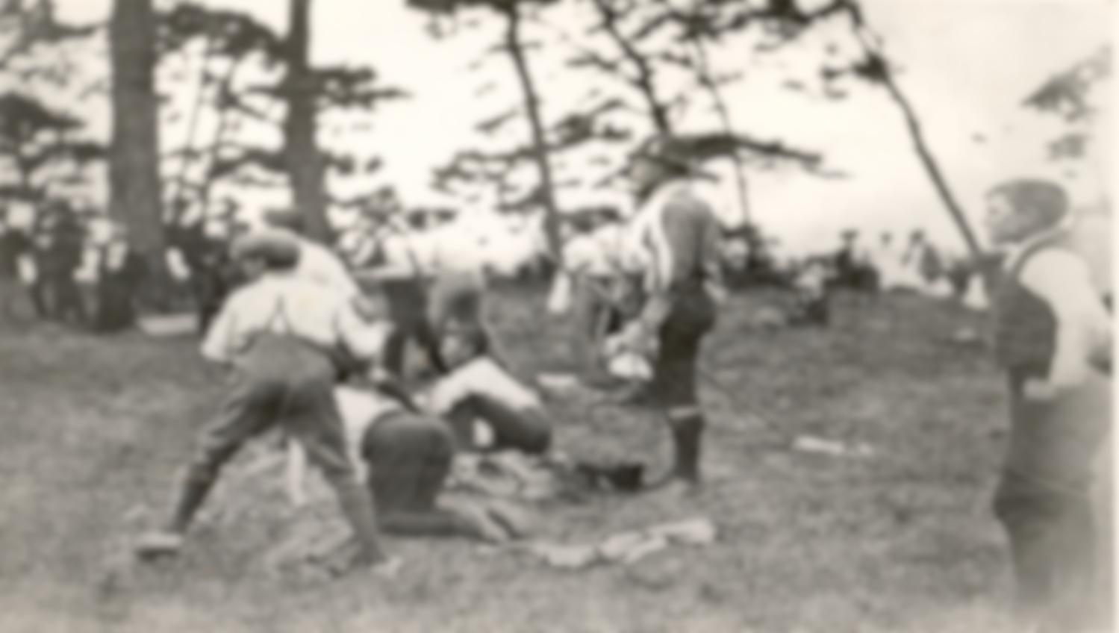



Tank you

Slide 4



Youth
Programme
Life cycle
Youth Programme
Policy
Youth
Programme
Content

Slide 5

Youth Programme
Content
How
What
Why

Slide 6

The Youth Programme in Scouting is the totality of the learning opportunities from which young people can benefit (What),
created to achieve the purpose of Scouting (Why),
and experienced through the Scout method (How).
Youth Programme
Definition

Slide 7



The purpose of scouting and its educational objectives
Development of active global citizens
Why
Empowerment of autonomous individuals

Slide 8

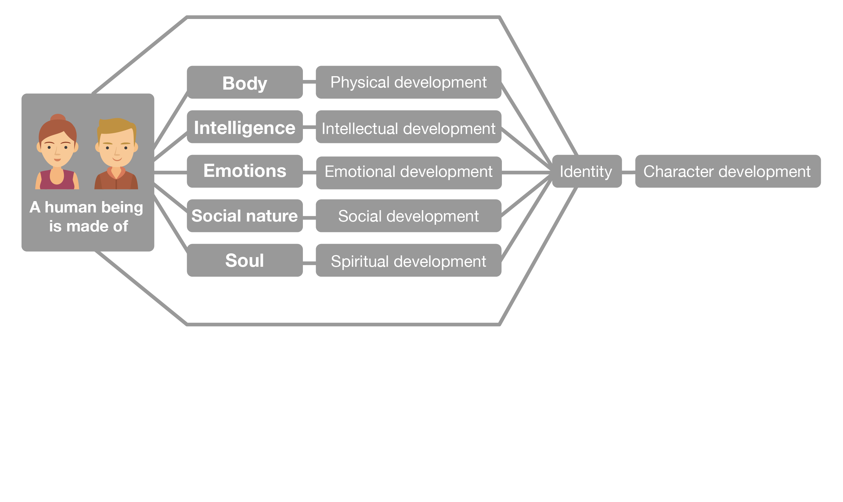
Areas of Personal Growth :

Slide 9
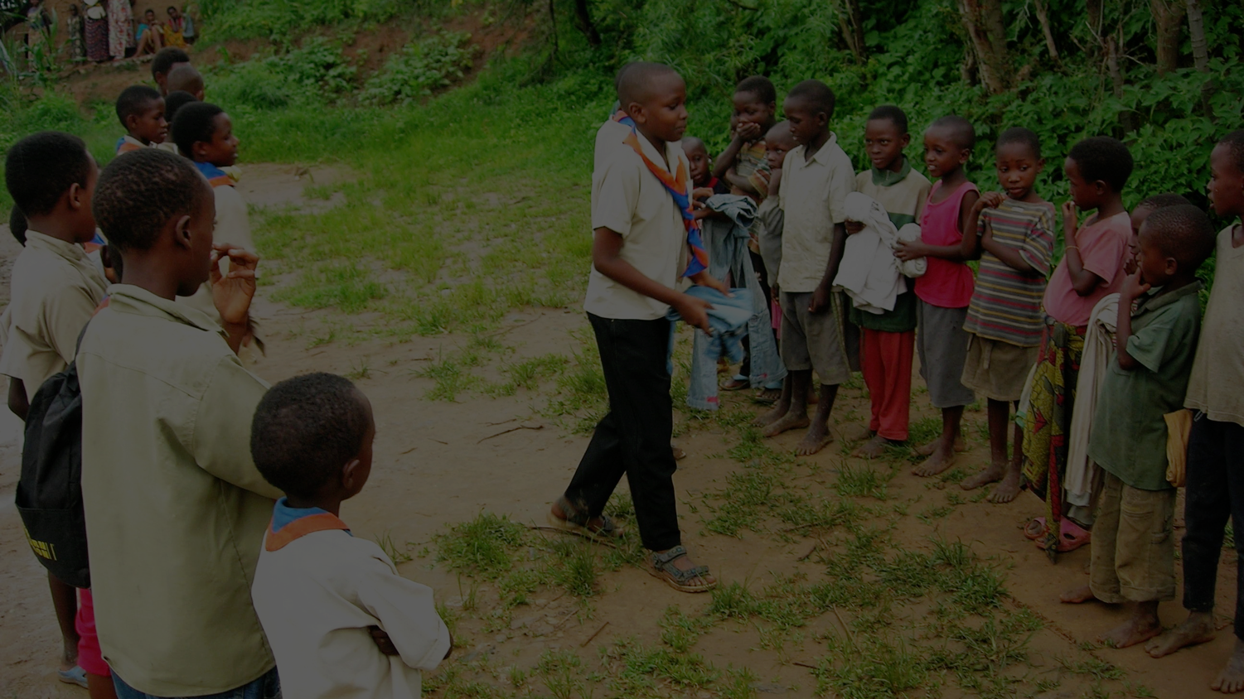
Creating Positive Change in Their Communities
Scouts as Active Citizens
Autonomous
Supportive
Responsible
Committed
Culturally sensitive

Slide 10

All learning opportunities in scouting from which young people can benefit
What
Don’t forget Youth Trends

Slide 11
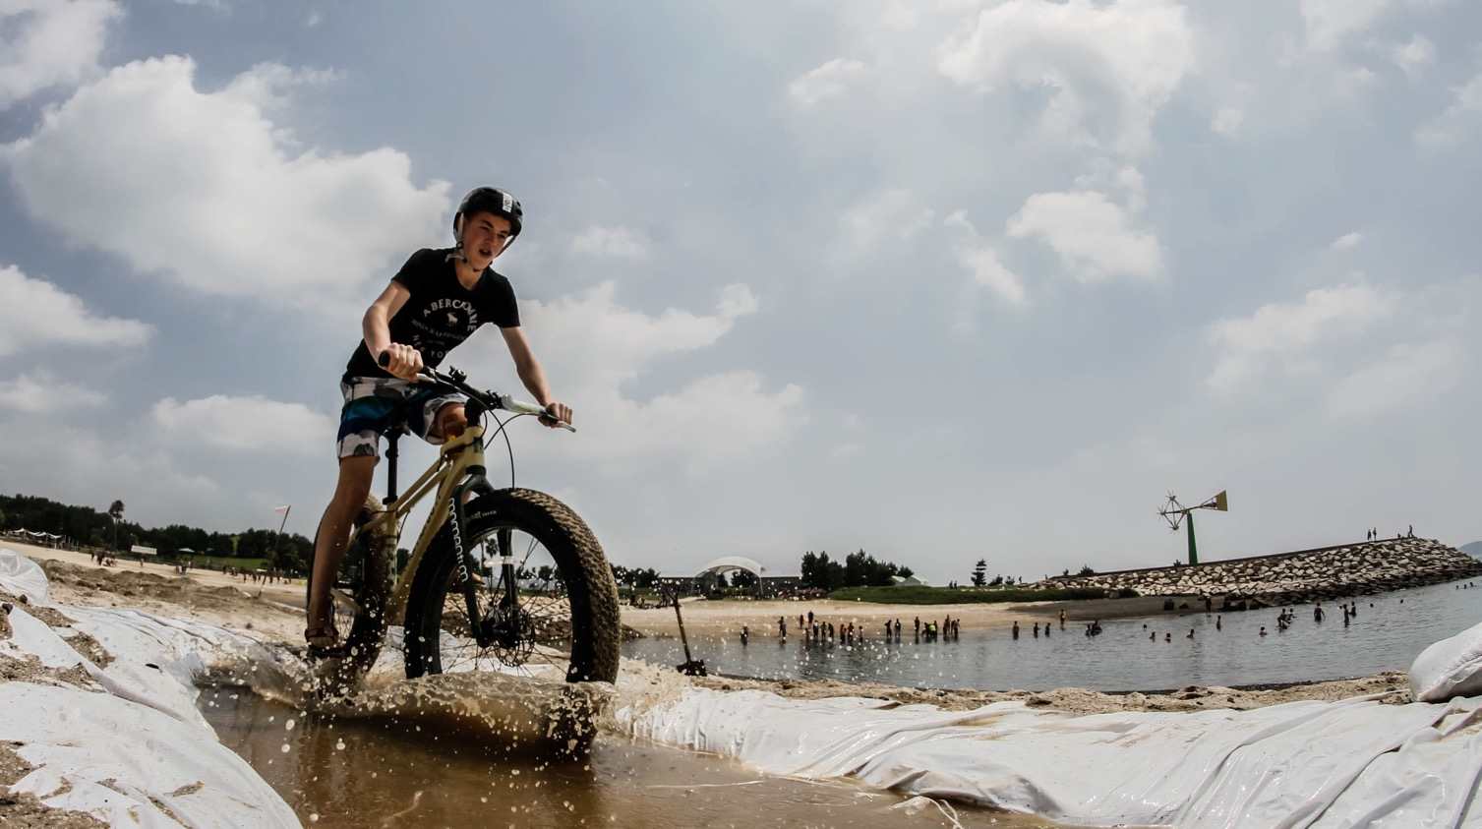










How
Through the Scout method
Notes:
The strategy document provides clarity on the priorities and purposes of WOSM (World and Regional) CSE activities. It also aims to provide a framework for NSOs on core issues such a brand, core messages and key activities that will maximise impact with limited resources.

Slide 12




Youth Programme
Life cycle
Process of
Youth
Programme
development
Implementation
of the
Youth
Programme

Slide 13

Process of Youth Programme development
A
R
RACE
C
Reflection
Analysis
Consideration
Evaluation
E

Slide 14





Roles and responsibilities
The
implementation of the Youth
Programme
Developer
Facilitator
Supporter
Youth
Programme

Slide 15

Have young people at its centre
Be about Education
Develop Active Citizens
Be locally adapted and globally united
Be up-to-date and relevant
Be open to all
Be attractive, challenging, and meaningful
7
Key Principles
for the Youth Programme

Slide 16

Co-ordination with others
Institutional documents and processes
Training and support of adults
Age sections
Promotion
Policy in
action:
How to use the
world scout youth programme policy

Slide 17

Time Frame for Review and Life Span
1st triennium is for adoption and promotion
2nd triennium is for actual implementation by NSOs.
3rd triennium is for continual implementation, full evaluation, and review by the WOSM structures.

Slide 18

50 MILLION SCOUTS IN OVER 220 COUNTRIES
AND TERRITORIES ARE CREATING
A BETTER WORLD…
Thank You

